Slide 1

e-Government
SG Government’s Adoption in Social Media
TEAM 6

Slide 2
Discussion Topic
Prepare a case study of a social media initiative undertaken by a Singapore government agency with primary data collection. How does the government organizes itself to deal with this media? In what ways is this considered a success or failure?

Slide 3
Presentation Overview
# | Topic | Presenter | Duration
1 | Fact sheets on current status of government’s adoption to social media | Rollei | 05 mins
2 | Assessment on how government is organizing itself to deal with social media.
 | Social Media Maturity Level in government agencies Agencies Survey | Joseph | 05 mins
 | Public View on Agencies’ Social Media Initiatives Public Survey Facebook analytics |  | 10 mins
3 | Topic Conclusion Challenges ahead |  | 05 mins
4 | Q & A | Team 6 | 05 Mins
* Total Slides : xxx
* Time Keeper: Rollei, Dayong
Total Duration : 30 Mins

Slide 4
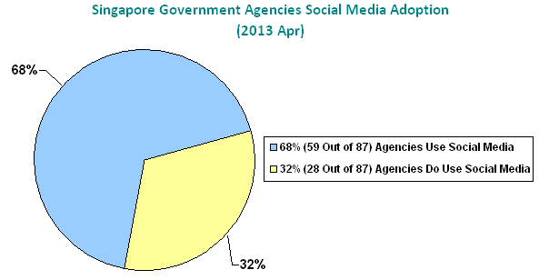
Fact sheets - 1/5

Slide 5
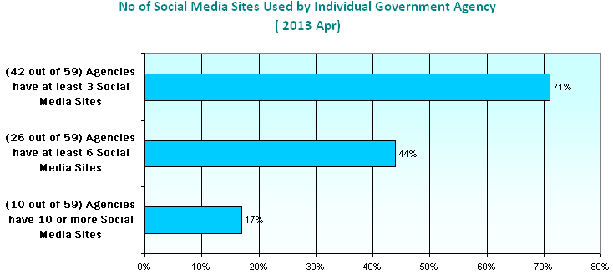
Fact sheets - 2/5

Slide 6
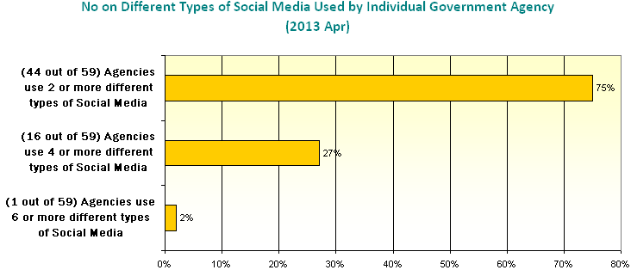
Fact sheets - 3/5

Slide 7
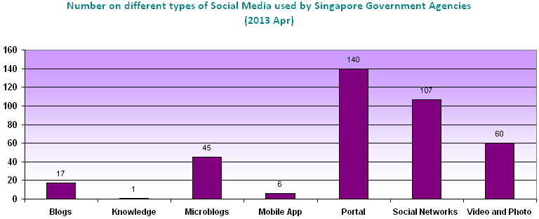
Fact sheets - 4/5

Slide 8
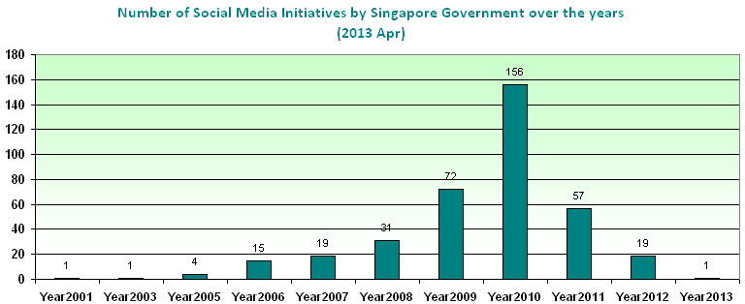

Fact sheets - 5/5

Slide 9
Summary on current status
The Singapore government recognizes that digital and social media are key channels for communicating and engaging with the public
Over the past few years, government agencies have increasingly leveraged on popular social media platforms to explain government policies, provide public education, reach out to the community, seek public feedback/ consultation, encourage citizen participation or market official events.

Slide 10
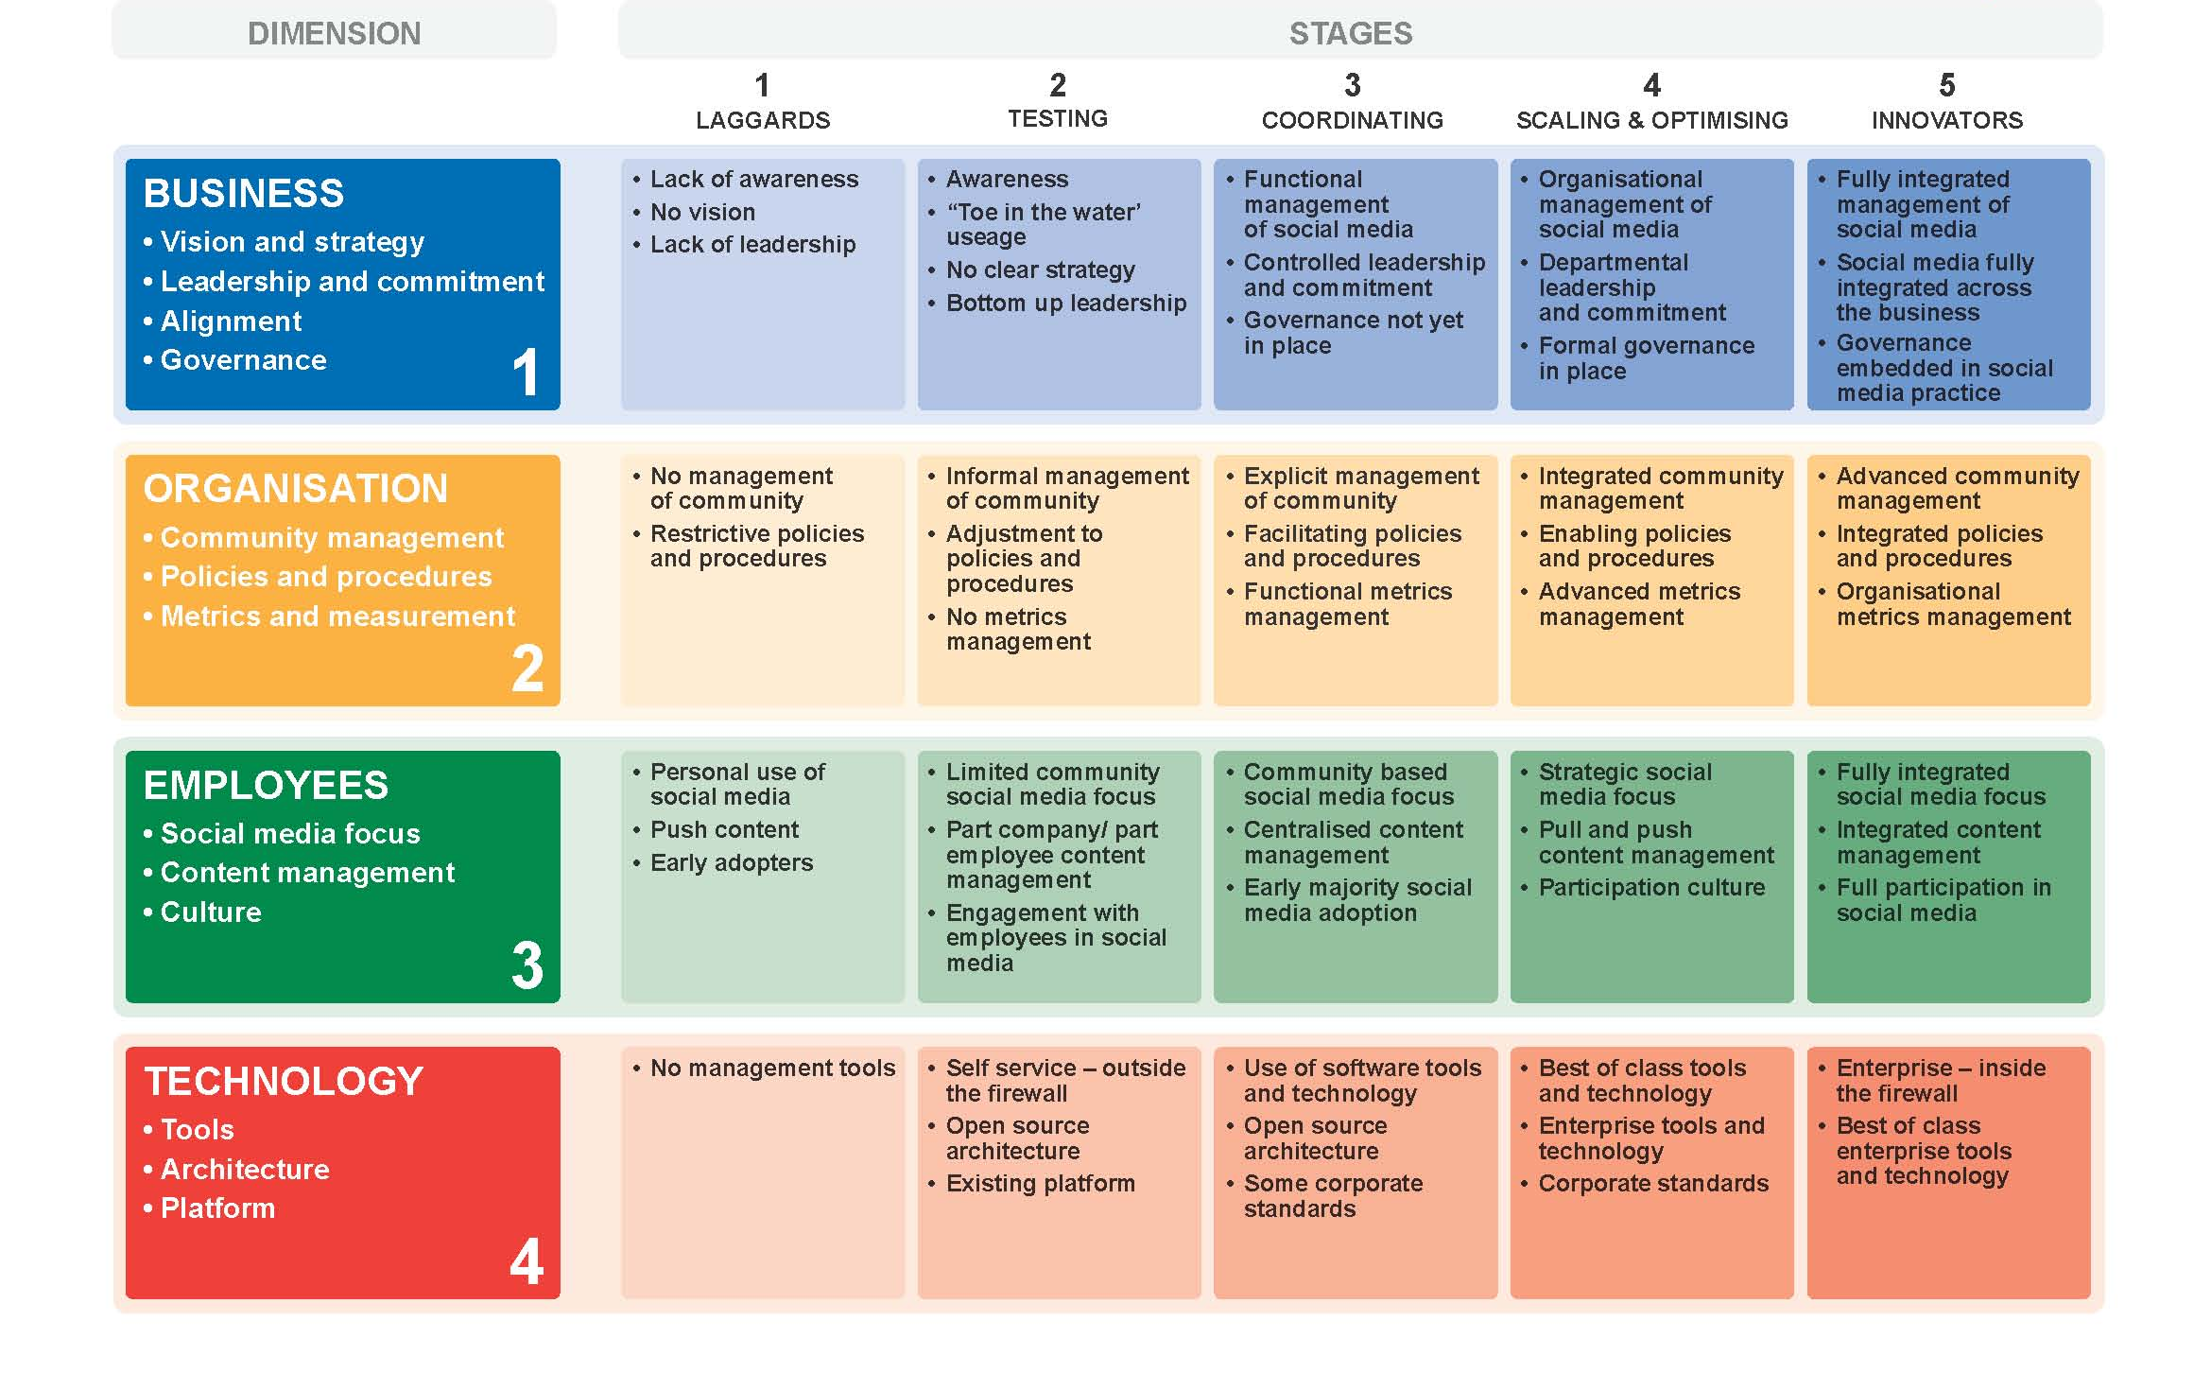
Social Media Maturity Model

Slide 11
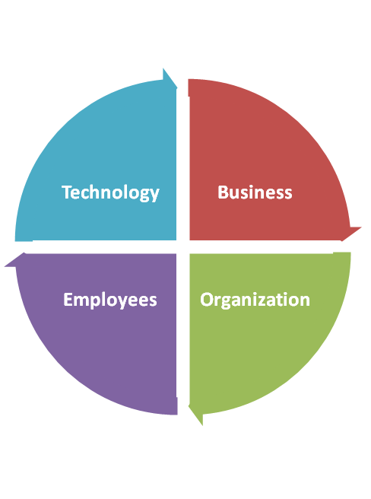
Maturity Evaluation
Tools
Architecture
Platform
Vision and strategy
Leadership and commitment
Alignment
Governance
Social media focus
Content management
Culture
Community management
Policies and procedures
Metrics and measurement

Slide 12
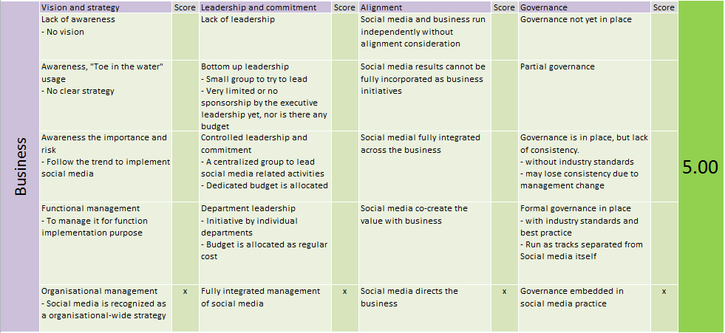
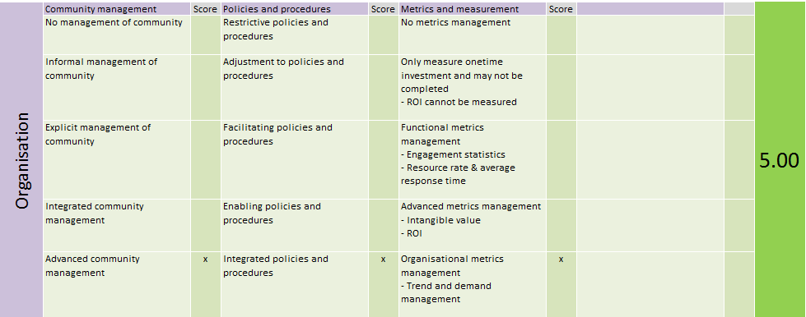
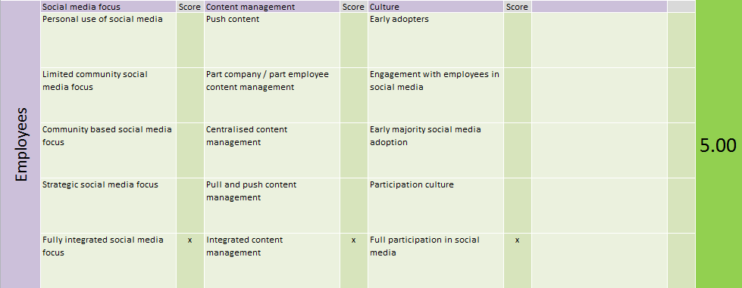
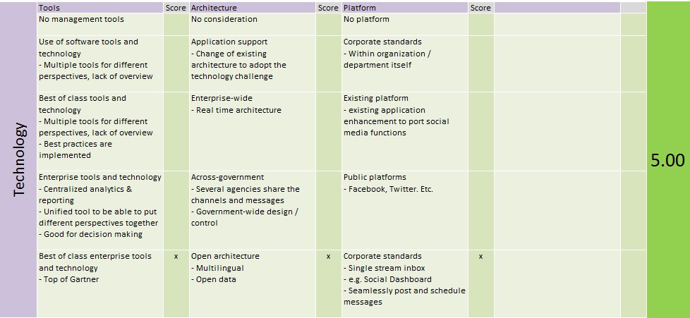
Measurement – Point System

Slide 13
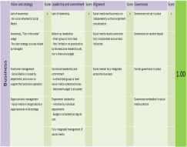
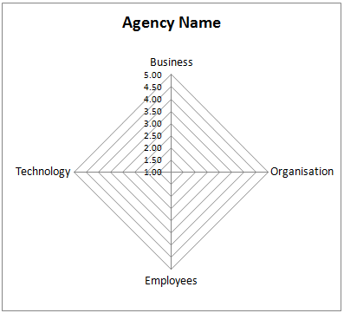
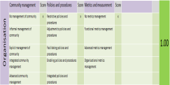
Measurement: from Conceptual to Measurable

Slide 14
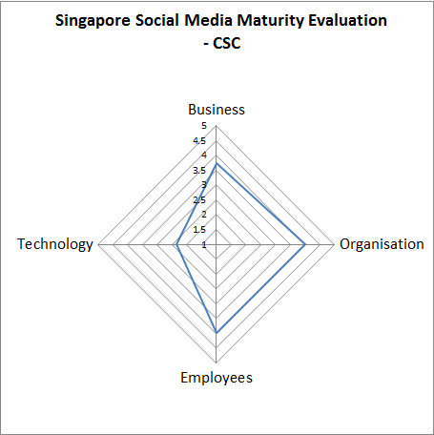
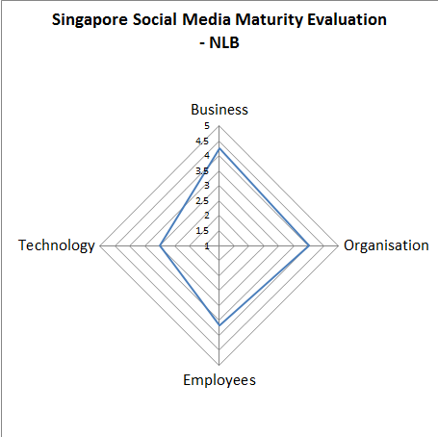
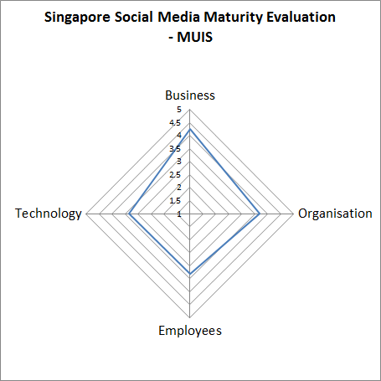
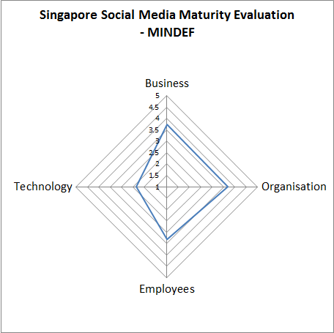
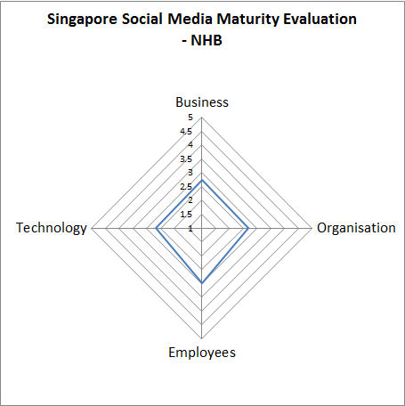
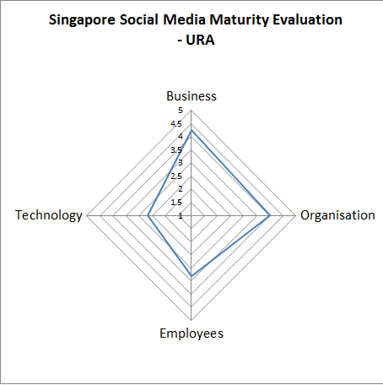
Agencies’ Survey Results

Slide 15
Agencies’ Survey Result Analysis
Strength in Business, Organisation and Employees
  Strategic Adoption of Social Media
  Appointing MCI to act as a social media advisor for public agencies
  Updated Organization Policies
  Trainings for public officers by Civil Service College
Lack of Technology support
Notes:
Strategic Adoption of Social Media
Part of the eGov2015 MasterPlan is leverage on social media to widen and deepen government engagement with the public. The plan will systematically guide the government to experiment new ways to use social media to disseminate information, explain issues, build relation and stay connected with the citizens.
Appointing MCI to act as a social media advisor for public agencies
Ministry of Communications And Information (MCI) formerly known as Ministry of Information, Communications and Arts (MICA) has also been appointed as the official social media advisor for public agencies. [x4] MCI will be responsible for supporting other government agencies’ use of social media through sharing of research on social media trends and providing advices to these agencies when needed. MCI had also issued guidelines to ministries on a coherent online strategy, rules of engagement and implementation.[x4]
-------------------------------------------------------------
Trainings for public officers
To ensure the government as a whole could be more active and adept in engaging Singaporeans online, government agencies in Singapore are set to get more structured training in social media usage. [x3] The ministry is currently working with Civil Service College to identify new media competencies needed by public officers, several training programmes will be rolled out for public officer’s participation to equip them with relevant competencies to deal with / and work with social media. [x3].

Slide 16
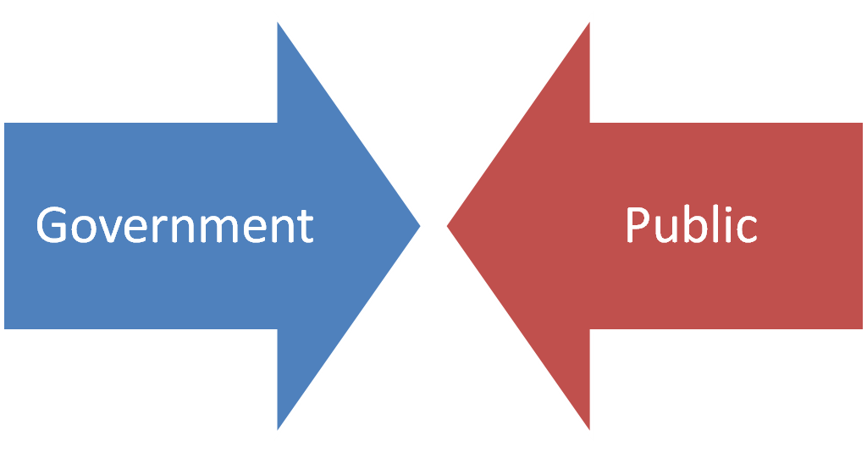
On the other side?

Slide 17
Public Survey
Objective
To gather the public view’s of current status of governments’ engagement in social media
To analyze the gap between government agencies’ views and public view of government adopting social media
To understand public expectation for governments’ engagement social media

Slide 18
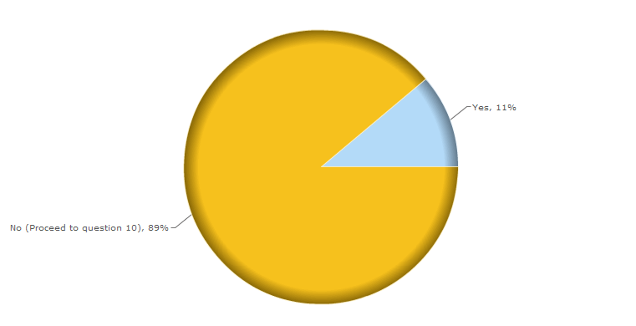
Public Engagement

Slide 19
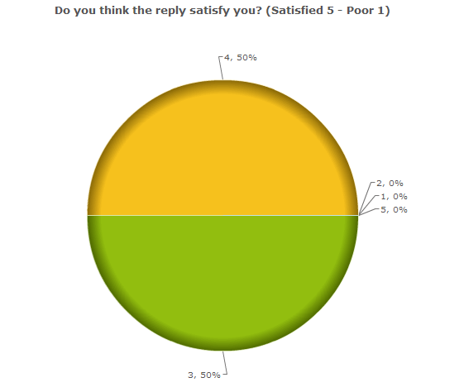
Fact Sheet – 2/6
Public Satisfaction

Slide 20
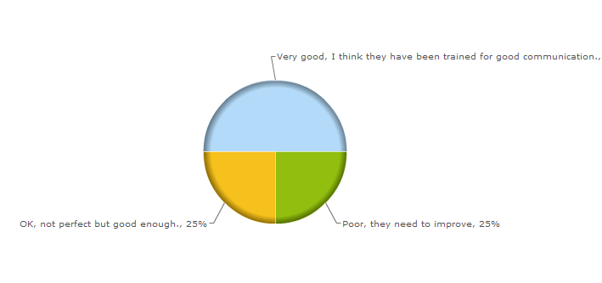
Fact Sheet – 3/6
Communication Skill

Slide 21
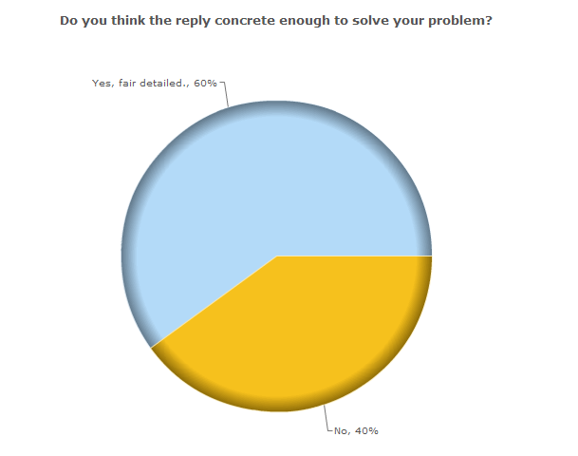
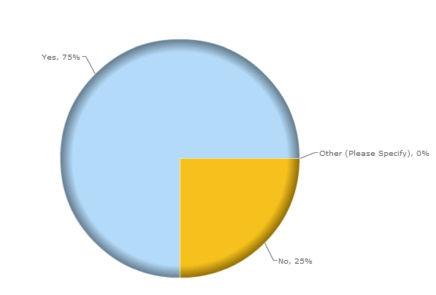
Fact Sheet – 4/6
Message Quality

Slide 22
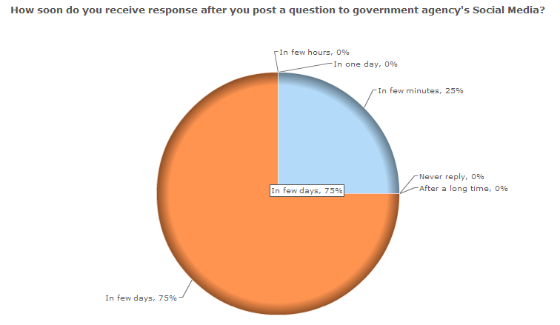
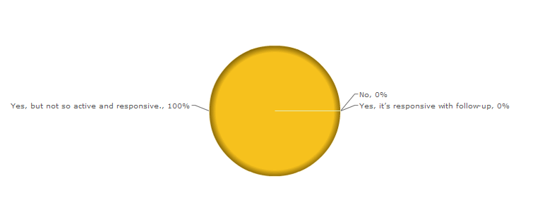
Fact Sheet – 5/6
Responsiveness

Slide 23
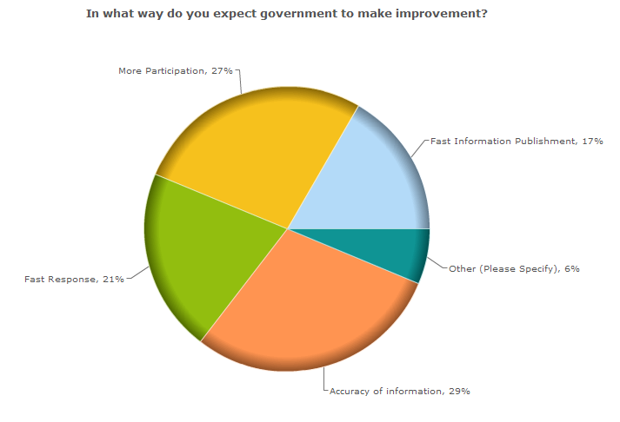
Fact Sheet – 6/6
Improvement

Slide 24
Public Survey Results Anlysis
Resource Constraint
Good quality of content
Process is not efficient
High expectation of public
Notes:
Summarize the previous analysis

Slide 25
Social Engagement & Metrics
Breadth
  Community Size
  Community Growth
Depth
  Conversions
  Viewing
Direct Engagement
  Engagement Volume
  Engagement Responsiveness
Reference - Howto.gov

Slide 26
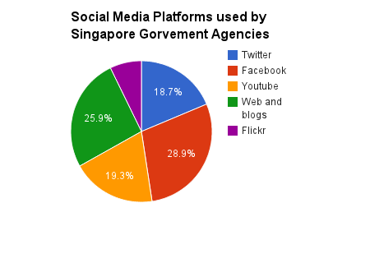
Popular Social Media Platforms

Slide 27
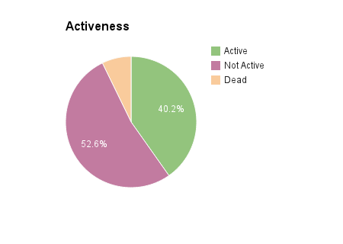
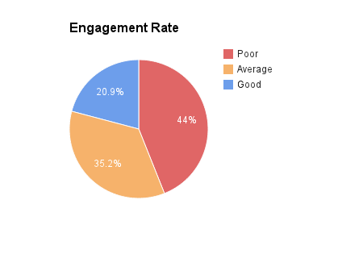
Facebook Analysis

Slide 28
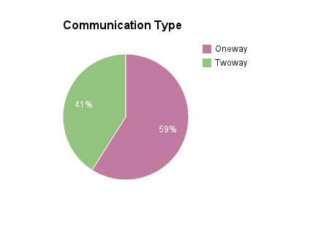
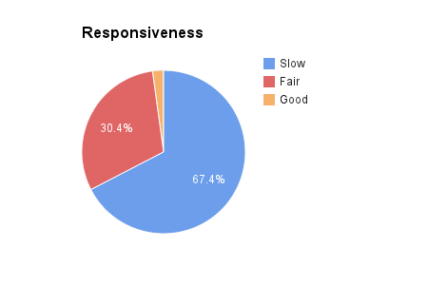
Facebook Analysis (cont)

Slide 29
Facebook Analytics Summary
Is it success or failure?
  Overall satisfaction- 70%
  Quality of content – 60%-70%
  Public Participation Rate – < 20%
  Engagement Rate – 40% on facebook
Notes:
How: The government establish processes, policies, guidelines to deal with social media, and government also continually improve it.
Success or failure: The overall satisfaction of public is about 70%, the quality of content is 60-70%, but the engagement rate is quite low

Slide 30
Topic Conclusion
How does the government organises itself to deal with Social media?
  Appointed MCI as a social media advisor for the ministries
  Process, policies, guidelines, structure changes
  Staff Training, Public education.
  Continual improvement
Assessment
  Considerably successful in adopting social media to engage the public
  Still in a early stage of adoption (lacks crowdsource, staff training and more public education)
  Is putting in effort to learn how to leverage on social media to create values, but is still in a learning process and is slowing adjusting itself
Notes:
How: The government establish processes, policies, guidelines to deal with social media, and government also continually improve it.
Success or failure: The overall satisfaction of public is about 70%, the quality of content is 60-70%, but the engagement rate is quite low

Slide 31
Challenges ahead
To keep up with the way citizen are now finding information and networking
Be prepared for key risks that social media presents
Educate and train public service staff
Analyses and capitalize on the opportunities that social media provides
Change the way government agencies work in order to response spontaneously and instantaneously

Slide 32
Challenges ahead (cont)
“As the environment continues to evolve, the Singapore government will continue to explore new digital channels to better reach out to and connect with the public. Besides digital channels, traditional offline channels remain important. Hence Government agencies have continued to adopt an integrated approach in public communications, combining both online and offline for optimal outreach” Jaime Goh MCI Quality Service Manager

Slide 33


Slide 34


